Slide 1
Grand theft auto ece 532 H1S
Group 8: Yaron Milwid, Milos Nikolic, Neil Veira
TA: Charles Lo
Prof: Paul Chow
March 31, 2017

Slide 2
Outline
Overview of the project and initial goals
Problems we had
Third party IP used
IP we made
Design process
What we learned
Demo

Slide 3
Overview of the project and initial goals
Create a simple autonomous car
Car navigates through an obstacle course
Obstacles are defined by a specific color
Video data is sent from the car to the processor via WiFi and processed using FPGA
Commands are sent to a PWM and then transmitted through a remote controller
We ended up achieving limited functionality of our initial goals

Slide 4
Problems we had
Vivado has many bugs
There are very few open-source JPEG decoders
The one we found was old, difficult to use, and buggy
There was very little documentation for the WiFi PMOD
Resources were severely limited
We used 87.4% of available BRAM and 78% of LUTS
Difficulty meeting timing constraints
Vivado version affects our design performance significantly
Microblazes are very slow (getting image from wifi and running pathfinding algorithm)

Slide 5

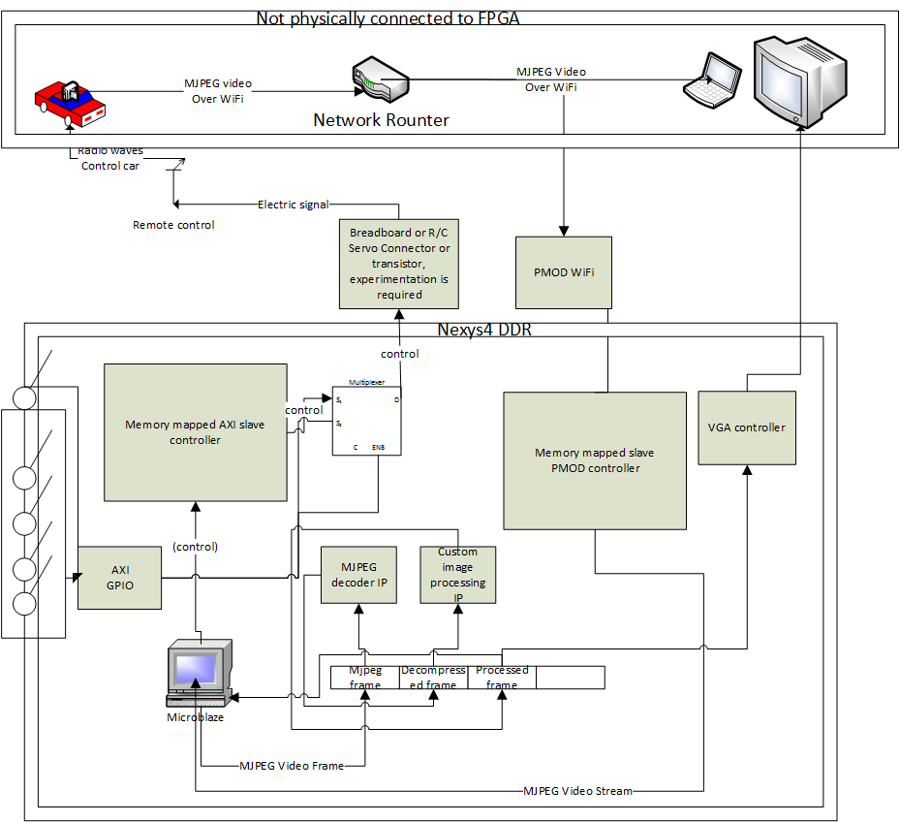
Original Flow Diagram

Slide 6
Revised Flow Diagram

Slide 7
Original Block Design

Slide 8
Revised Block Design

Slide 9
Third party IP used
WIFI PMOD from Digilent
Includes the TCP client code that we adapted
JPEG decoder from Opencores.org
IP webcam phone app
VGA driver by Rob Chapman (Altera University Program 1998)
Xilinx IP used
FIFO Generator
DRAM, BRAM
Microblaze infrastructure (x2)
AXI infrastructure
Clock generator

Slide 10
IP we made
Image processing (colour thresholding and edge detection)
Control algorithm
PWM
VGA controller (uses third party IP to generate Hsync & Vsync signals)

Slide 11
Design process
Develop high-level concept
Constraints, criteria
Divide design into independent components and assign to different members
WiFi
Image processing (jpeg decoding + edge detection)
Path-finding and control algorithm
Remote controller module with PWM
Verify and test components independently
Integrate components

Slide 12
What we learned
Skills
Verilog
HTTP
Path-finding
VGA
Don’t trust test benches with open source IP to be thorough
Don’t use different versions of software simultaneously
Copy all files into projects
Check constraints manually since they are not validated by Vivado until generate bit-stream
When Vivado behaves unexpectedly, restart it

Slide 13
Demo

